Slide 1


04/11/2026
JOSH LLOYD
Sobriety Support App
A presentation preview on the idea, features, and value of a digital recovery companion

Slide 2

04/11/2026
Agenda
Introduction and Purpose
Features and User Engagement
Design, Development, and Ethics
02.

Slide 3

04/11/2026
Introduction and Purpose
03.

Slide 4


04/11/2026
Introduction and Purpose
Why it matters
Recovery can feel unpredictable
Cravings, stress, and low motivation can make consistency difficult.
Support is needed between sessions
People often benefit from simple daily help outside formal services.
An app adds everyday structure
Tracking and reflection make progress visible and easier to sustain.
04.

Slide 5
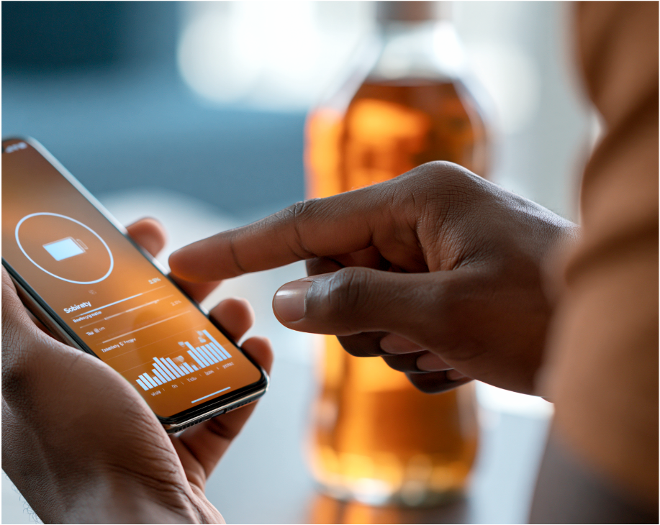
04/11/2026
Introduction and Purpose
Support, Not Judgment
Build healthier routines
Simple self-monitoring helps turn intentions into daily habits.
Stay focused on progress
Tracking time since your start date makes progress feel real.
Reconnect with your “why”
Motivation and reflection features remind you why you started.
Commit one day at a time
Daily check-ins support consistency, even on difficult days.
Supportive, not judgmental
The experience is designed to encourage users, not shame them.
05.

Slide 6
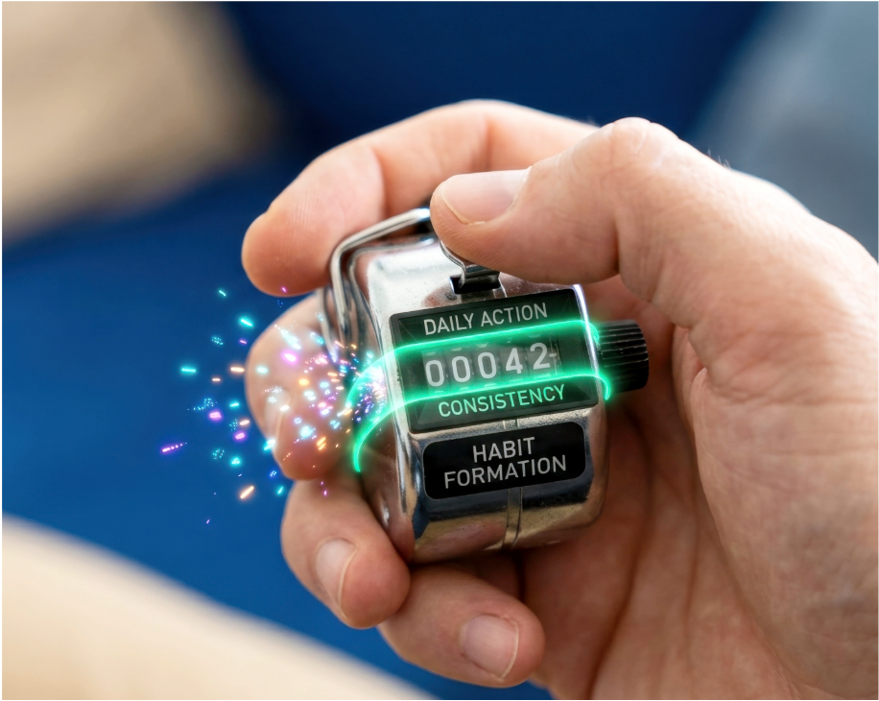
04/11/2026
Introduction and Purpose
Who It Helps
Intended users
People who want to reduce or stop a harmful habit.
Anyone seeking a private tool to support day-to-day progress.
What users often need
Encouragement during cravings, stress, and low motivation periods.
Simple routines and reminders that keep personal goals visible.
06.

Slide 7
04/11/2026
Features and User Engagement
07.

Slide 8




04/11/2026
Features and User Engagement
Core Features
Secure access
Sobriety tracker
Daily check-ins
Motivation and reflection
Users register and log in to keep progress private.
Choose a habit to stop and set a start date.
A counter shows time sober so progress stays visible.
Confirm today’s commitment and record optional notes.
Revisit personal reasons for quitting during tough moments.
Supportive prompts highlight milestones and small wins.
08.

Slide 9

04/11/2026
Features and User Engagement
Keeping Users Engaged
Daily reflection habit
A short daily check-in keeps the goal front of mind.
Optional notes help users spot triggers and what is working.
Visible progress momentum
Progress summaries turn small wins into a clear story over time.
Revisiting personal reasons for quitting strengthens commitment.
Encouragement when it’s hard
Supportive messages provide reassurance during cravings, stress, or low motivation.
09.

Slide 10
04/11/2026
Design, Development, and Ethics
10.

Slide 11
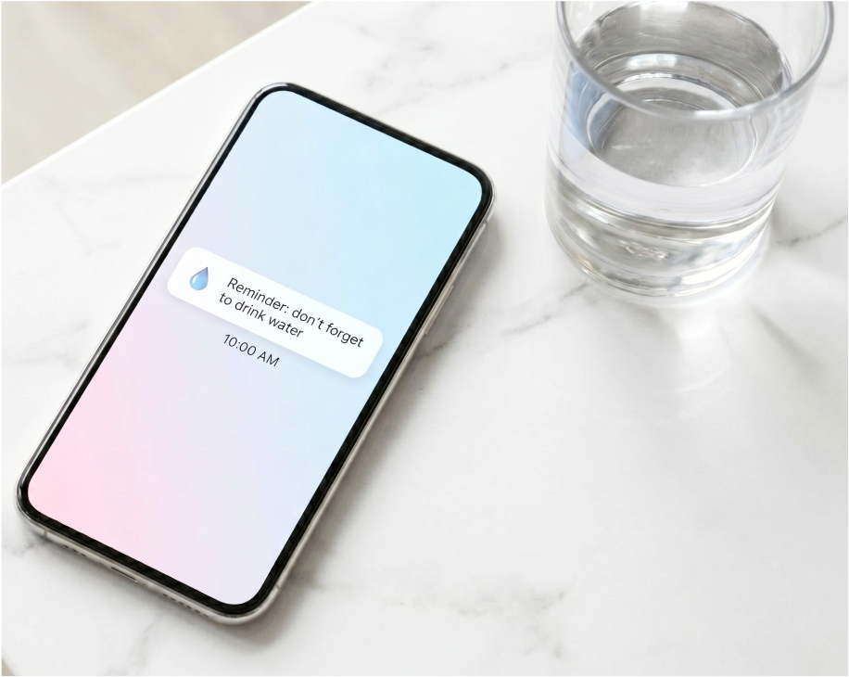
04/11/2026
Design, Development, and Ethics
Research-Driven Design
What the research explores
It examines what drives motivation and what makes staying sober hard.
It focuses on cravings, stress, and consistency challenges over time.
Learning from existing apps
Similar tools are reviewed to understand common, helpful feature patterns.
This comparison highlights what works well and what can improve.
Turning insight into features
Findings guide tracking, reflection, and motivation tools that feel relevant.
The aim is a design based on real needs, not assumptions.
11.

Slide 12



04/11/2026
Design, Development, and Ethics
App Build Approach
Frontend build options
Use HTML, CSS, and JavaScript or PowerApps to create screens.
Prioritise simple navigation and clear daily actions for users.
Backend and data storage
Support accounts, sobriety start dates, and daily check-in entries.
Ensure progress and notes are saved reliably and retrieved quickly.
Secure, dependable database
Store personal progress in a database built for privacy and accuracy.
12.

Slide 13

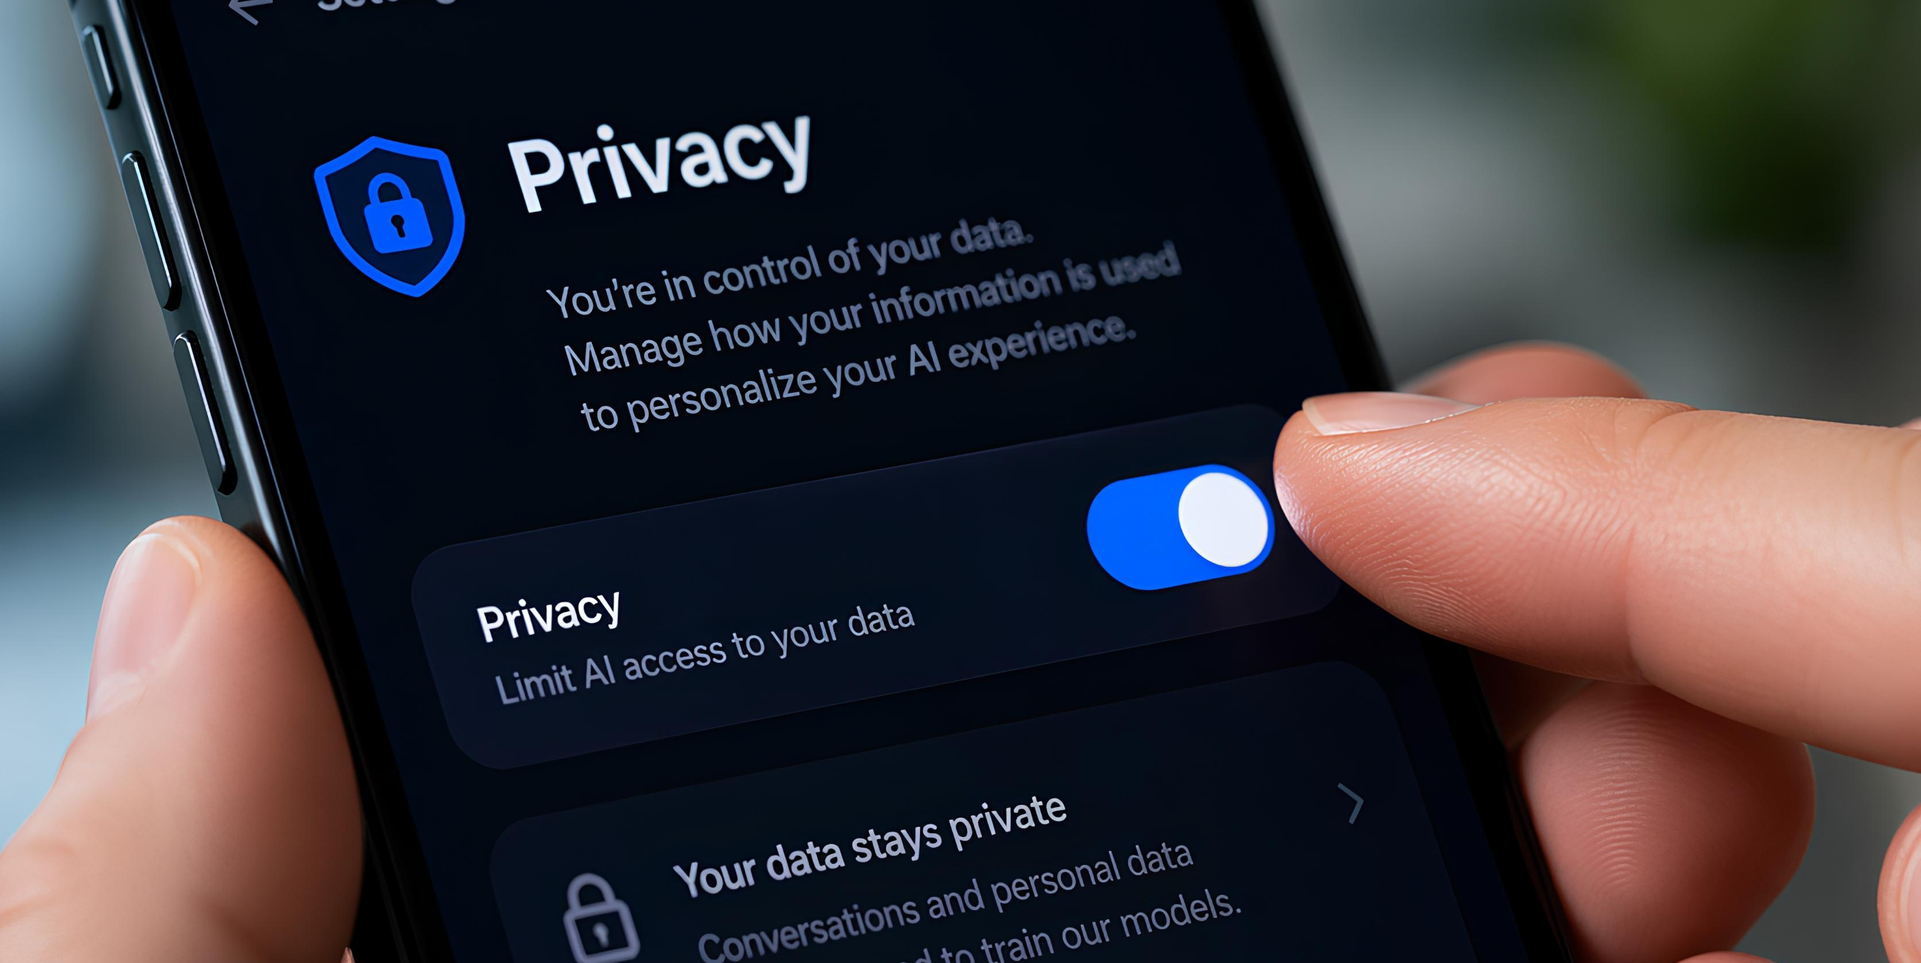

04/11/2026
Design, Development, and Ethics
Privacy Comes First
Treat sobriety data as sensitive
Assume entries are personal, and protect them from unwanted exposure.
Use careful wording and avoid prompts that pressure disclosure.
Collect only what is needed
Keep tracking focused on dates, goals, and optional check-in notes.
Do not ask for detailed substance histories unless essential.
Consent and legal compliance
Explain what is stored and why, before users begin.
Handle data responsibly under UK GDPR and the Data Protection Act 2018.
13.

Slide 14

04/11/2026
Design, Development, and Ethics
Phased Build Plan
Plan and design first
Confirm the scope, users, and key goals with a clear plan.
Create wireframes and map the user journey before building.
Build the core foundation
Develop login, basic navigation, and the sobriety tracking counter.
Set up reliable storage so progress and check-ins are saved.
Add and refine features
Introduce daily check-ins, motivation tools, and user settings.
Test, fix issues, and improve usability to build trust.
14.

Slide 15
04/11/2026
Design, Development, and Ethics
From Tracking to Impact
See progress, build momentum
Track your starting point
Check in every day
Reflect on your reasons
Protect privacy and trust
Set the habit and start date; see days sober grow
Confirm commitment and add optional notes
Revisit personal motivations when cravings hit
Summaries make small wins visible and motivating
Collect minimal data; handle it responsibly
15.

